Slide 1
Fundamentals of Machine Learning Week 7: Unsupervised learning Working on final project
Jonas Moons
All images are either own work, public domain, CC-licensed or fair use
Credits on last slide

Slide 2
Evalytics survey
https://app.evalytics.nl/#/login
Choose: Evaluate with code
Code: rkd-256

Slide 3
Program
0-1.5 hours: short lecture
Clustering
Presentations
>1.5 hours: project supervision / help in small groups
Participants in AI research project get separate supervision next week

Slide 4
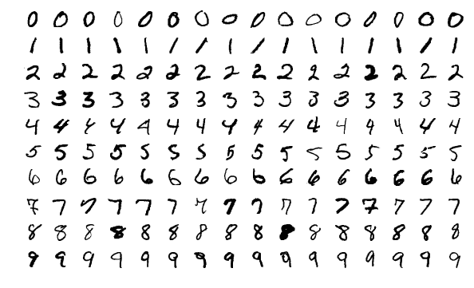
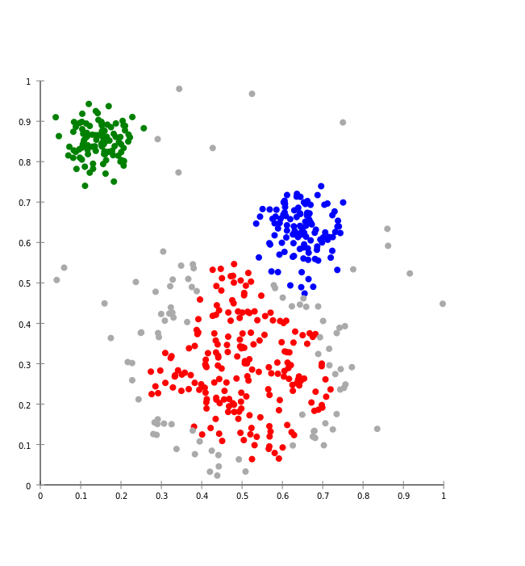

Supervised vs. unsupervised learning
Supervised: use known patterns to predict new cases
Handwriting recognition
Unsupervised: you let the algorithm discover patterns/clusters on its own
Spotify Radio / Discover Weekly
MNIST data set

Slide 5
Why clustering?
To discover interesting and useful clusters in the data and adapt our content or marketing strategy
For instance, different user types based on behavior (user profiling), e.g.
Explicit: likes, favorites, ratings, comments, etc.
Implicit: pages visited, content seen, mouse movements, etc.

Slide 6
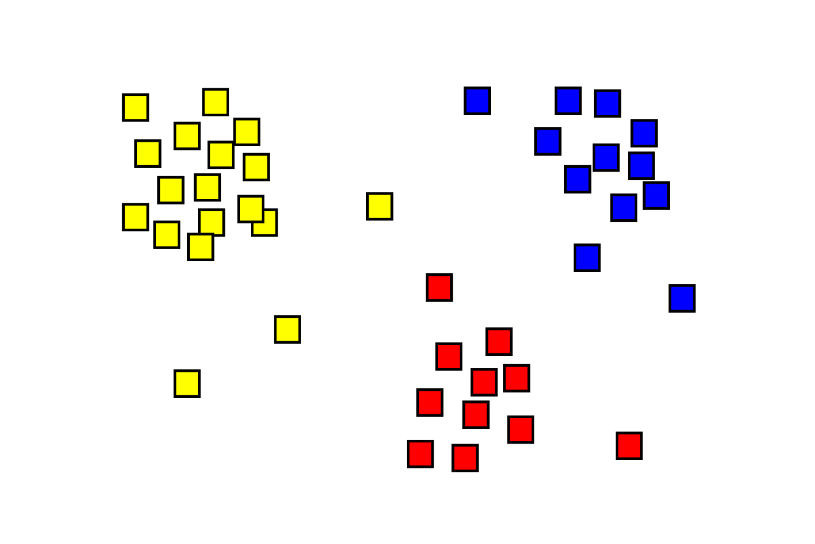
What is clustering?
Assign observations to several clusters
It’s not always clear which solution is ‘correct’
There are many algorithms; we will use k-means (simple to understand but often suboptimal)
Remember: shown as 2-dimensional here but n-dimensional in reality, n being the number of variables used

Slide 7
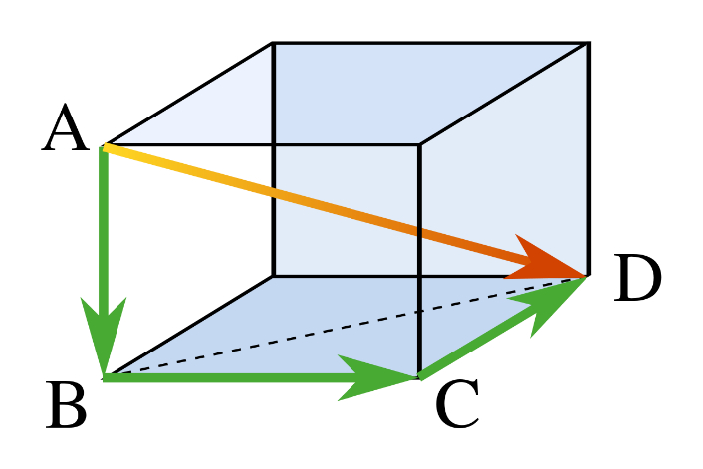
Distance
Each user is represented by a point in space
Each item (movie) is a dimension
The distance between two users can be calculated for any number of dimensions/movies (shown: 3)
User | Movie 1 | Movie 2 | Movie 3
1 | 5 | 3 | 5
2 | 4 | 1 | 2

Slide 8
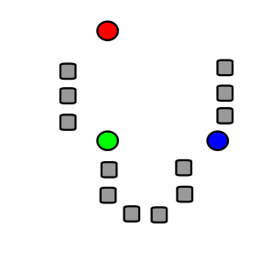
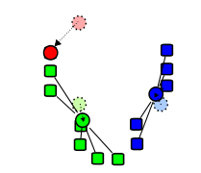
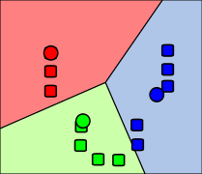
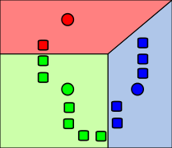
k-means algorithm
1. Start with k cluster centers at random
2. Assign each observation to nearest center
3. Move cluster centers to center of observations
4. Repeat until stable

Slide 9
K-means clustering

Slide 10
Exercise: clustering Iris data set (1)
In this exercise, you will explore the logic of clustering using the famous Iris data set. See the Exercise folder for the data set (iris.csv), and the Notebook k-means in the Examples folder.
Read in the csv file.
Using a Seaborn scatterplot, plot the Iris data set with petal length on the x-axis and sepal length on the y-axis. Plot the different Iris species with a different symbol (see the Seaborn documentation).
What possible clusters do you see with the naked eye? How do they relate to the three species?
Using k-means clustering with 3 clusters (using only petal length and sepal length as X variables), create a new variable cluster and use this to make another scatterplot, using color for cluster.
How does k-means perform?
Try out different numbers of clusters to see what happens. What seems like the ‘natural’ number of clusters for this data set?

Slide 11
Exercise: clustering Iris data set (2)
In this exercise, you will explore the logic of clustering using the famous Iris data set. See the Exercise folder for the data set (iris.csv), and the Notebook k-means in the Examples folder.
Read in the csv file.
Using a Seaborn scatterplot, plot the Iris data set with petal length on the x-axis and sepal length on the y-axis. Plot the different Iris species with a different symbol (see the Seaborn documentation).
What possible clusters do you see with the naked eye? How do they relate to the three species?
Using k-means clustering with 3 clusters (using only petal length and sepal length as X variables), create a new variable cluster and use this to make another scatterplot, using color for cluster.
How does k-means perform?
Try out different numbers of clusters to see what happens. What seems like the ‘natural’ number of clusters for this data set?

Slide 12
Problems with k-means
k-means can only make Voronoi cells (straight lines)
Suitable number of clusters often hard to determine in practice

Slide 13
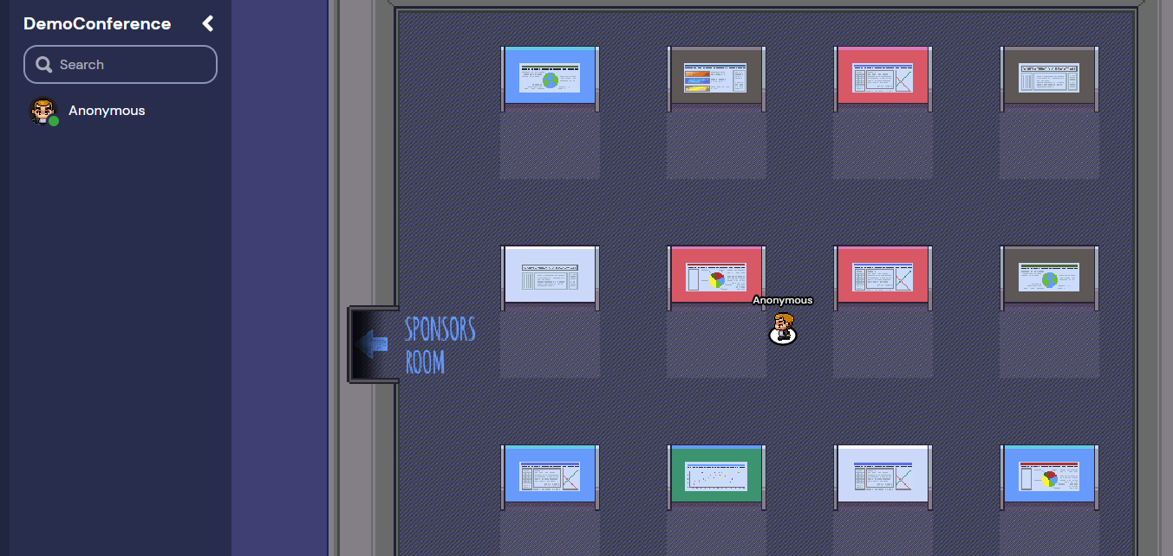
Presentation
Week 9
D02: Wednesday 20th January
D01: Friday 22nd January
You get short feedback from peers and from me via e-mail
Physical or online → what is your preference? Definitive details end of next week
If physical:
Presentations of 5 min. with max. 5 slides
In groups of 6-8 (schedule to be sent)
Streamed online via Teams (unless you object) for peers, family and friends
Possible to participate online
If online:
Poster presentation in Gather
PDF with simple poster

Slide 14
Format
Introduction: in which you define the context, the research question and the practical relevance
Data set: in which you explain how you acquired the data, and show your data cleaning steps
Feature engineering: in which you explain which transformations you have made to make your variables more informative (e.g., calculating number of days from a starting date)
Descriptive analysis: in which you show relevant graphs, tables and numbers with respect to your problem
Predictive model: in which you explain which analysis you have chosen and why. In which you build a relevant statistical model or train a machine learning algorithm.
Evaluation: in which you evaluate the model: numerically, qualitatively and in terms of practical value.

Slide 15
Peer groups
This week (w7) & next week (w8)
Discussion and Q&A on final assignment & weekly assignments
Topic is up to you: present your work, ask questions
Max. 4 minutes per person
Maybe you can form a Whatsapp / Teams chat to encourage and help each other?

Slide 16
Image credit
Pythagoras by CheCheDaWaff (CC-BY-SA)
K-means algorithm pictures by Weston.pace (CC-BY-SA)
K-means gif by Chire (CC-BY-SA)

